Slide 1
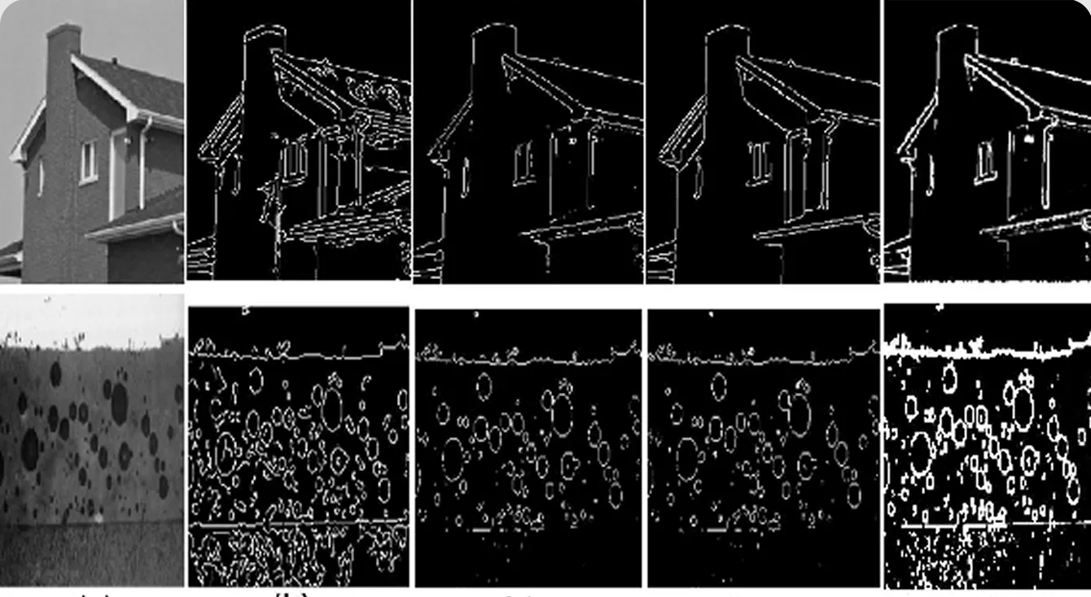
Lecture 2: Edge detection
CS4186: Computer Vision
Prof. Zhu Zhiyu

Slide 2
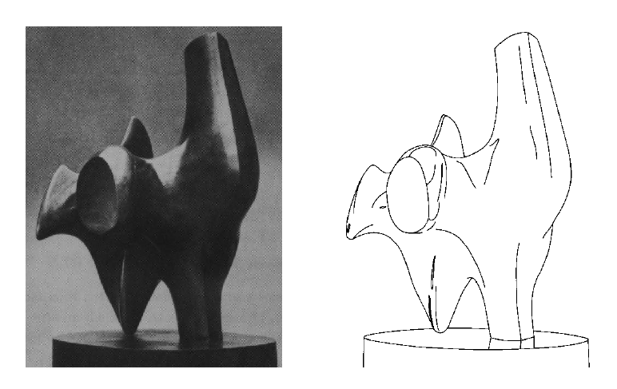
Edge detection
Convert a 2D image into a set of curves
  Extracts salient features of the scene
  More compact than pixels
TexPoint fonts used in EMF.
Read the TexPoint manual before you delete this box.: AAA

Slide 3
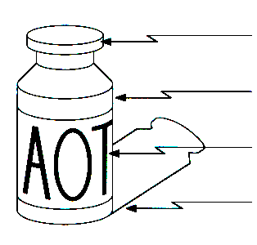
Origin of edges
surface normal discontinuity
depth discontinuity
surface color discontinuity
illumination discontinuity
Edges are caused by a variety of factors

Slide 4
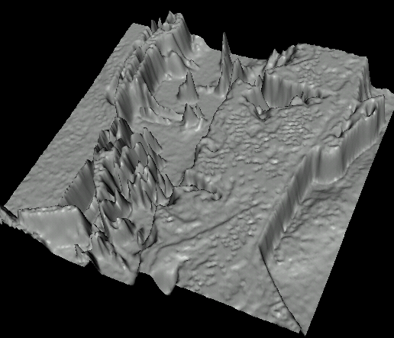

Images as functions…
Edges look like steep cliffs

Slide 5

Characterizing edges
An edge is a place of rapid change in the image intensity function
intensity function
(along horizontal scanline)
image
first derivative
edges correspond to
extrema of derivative
Source: L. Lazebnik

Slide 6
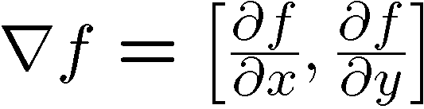
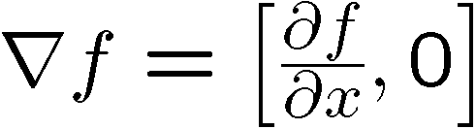
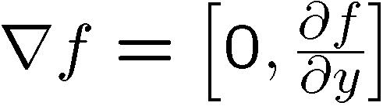
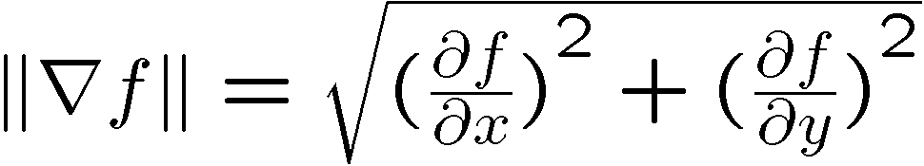
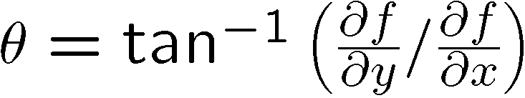
Image gradient
The gradient of an image:
The gradient points in the direction of most rapid increase in intensity
The edge strength is given by the gradient magnitude:
The gradient direction is given by:
  how does this relate to the direction of the edge?
Source: Steve Seitz
Notes:
give definition of partial derivative: lim h->0 [f(x+h,y) – f(x,y)]/h

Slide 7
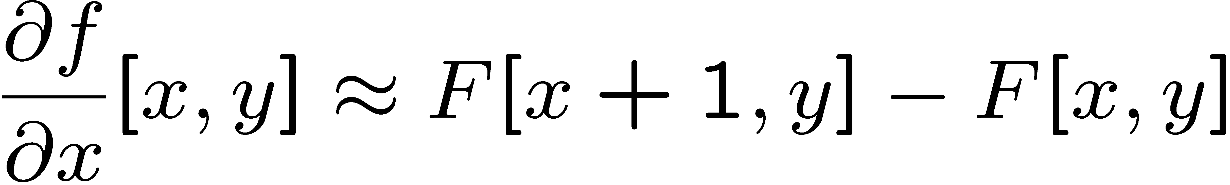




Image derivatives
How can we differentiate a digital image F[x,y]?
  Option 1: reconstruct a continuous image, f, then compute the derivative
  Option 2: take discrete derivative (finite difference)
How would you implement this as a linear filter?
1 | -1
 | -1
 | 1
:
:
Source: S. Seitz

Slide 8
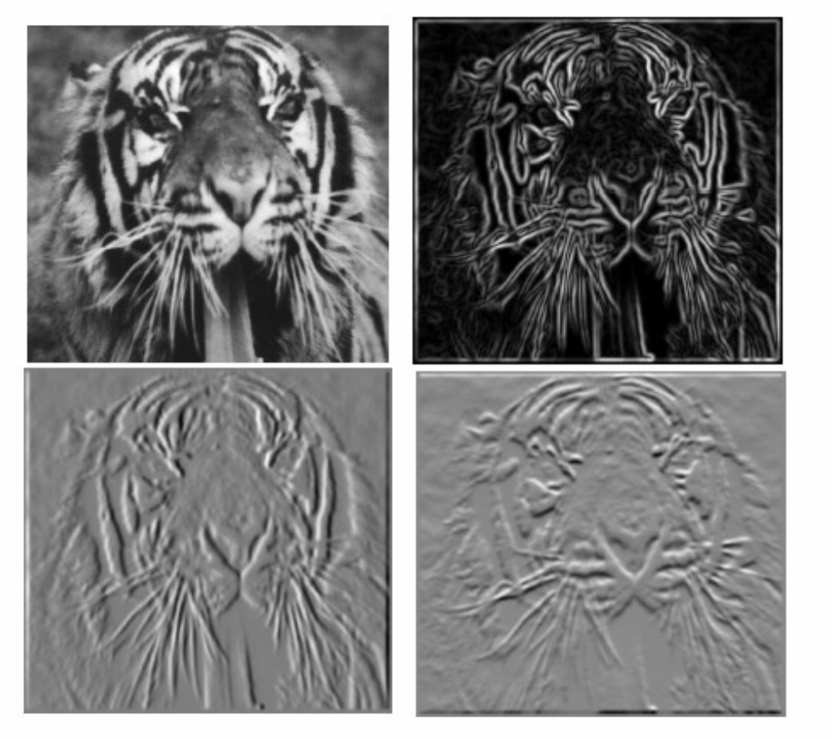
Image gradient
Source: L. Lazebnik

Slide 9

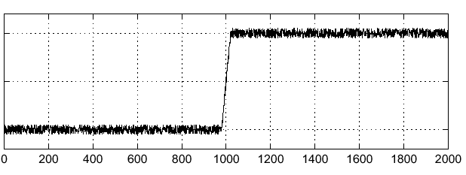

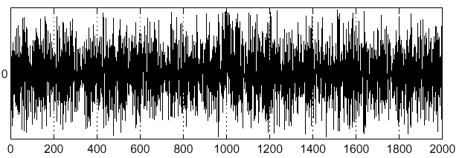
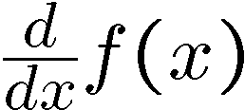
Effects of noise
Noisy input image
Where is the edge?
Source: S. Seitz
Notes:
How to fix?

Slide 10
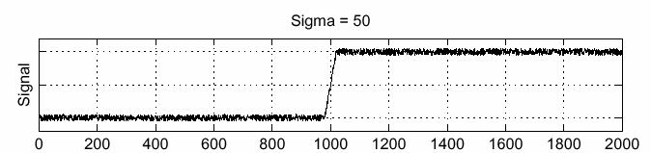
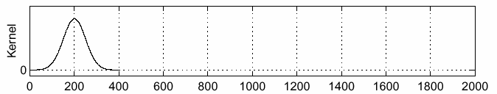
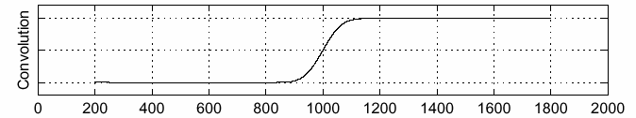
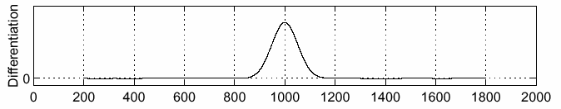
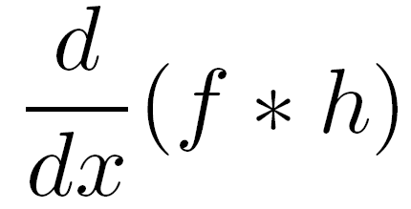
Solution: smooth first
f
h
f * h
To find edges, look for peaks in
Source: S. Seitz

Slide 11
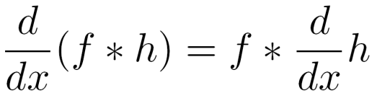
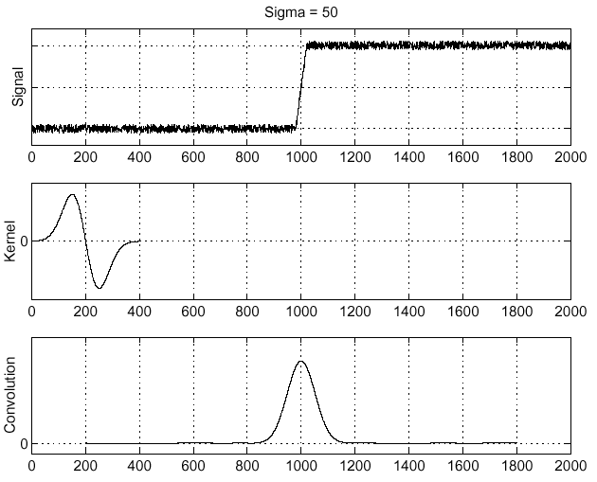
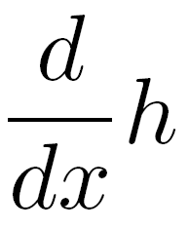
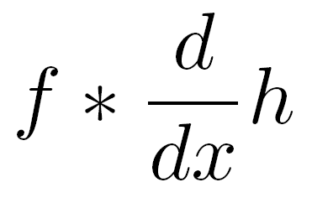
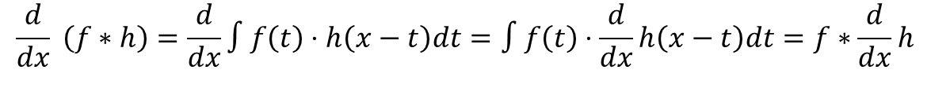
Associative property of convolution
Differentiation is convolution, and convolution is associative:
This saves us one operation:
f
$$\frac{d}{dx} \left(f∗h\right)=\frac{d}{dx}∫f\left(t\right)⋅h\left(x−t\right)dt=∫f\left(t\right)⋅\frac{d}{dx}h\left(x−t\right)dt=f∗\frac{d}{dx}h$$
Source: S. Seitz

Slide 12
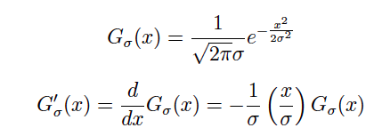
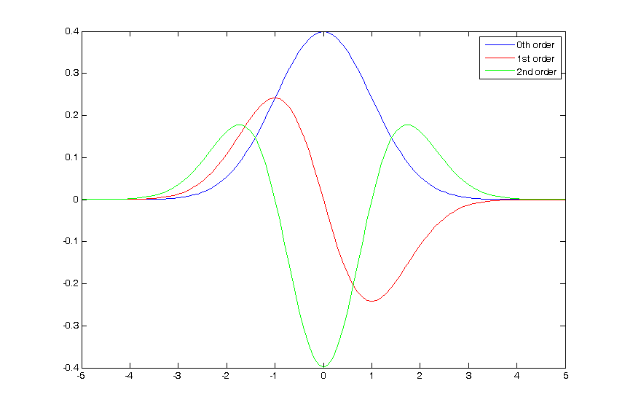
The 1D Gaussian and its derivatives

Slide 13
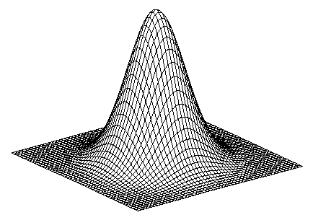
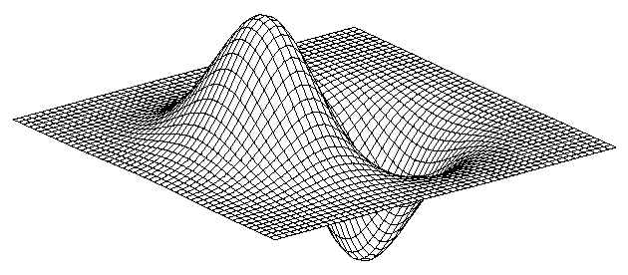
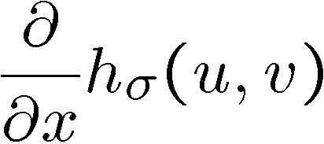
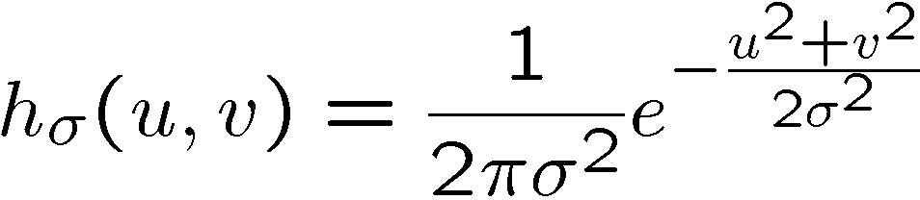
2D edge detection filters
derivative of Gaussian (x)
Gaussian
Notes:
How many 2nd derivative filters are there? There are four 2nd partial derivative filters.
In practice, it’s handy to define a single 2nd derivative filter—the Laplacian

Slide 14
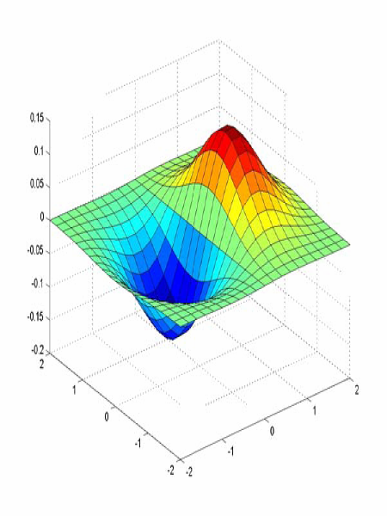
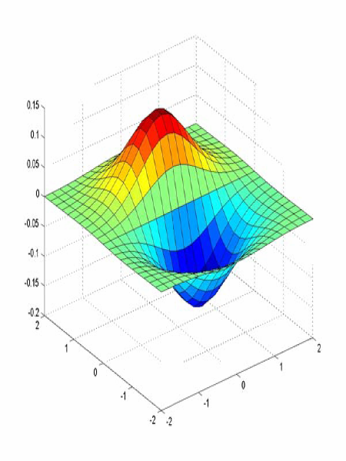
Derivative of Gaussian filter
x-direction
y-direction

Slide 15



The Sobel operator
Common approximation of derivative of Gaussian
-1 | 0 | 1
-2 | 0 | 2
-1 | 0 | 1
1 | 2 | 1
0 | 0 | 0
-1 | -2 | -1
The standard definition of the Sobel operator omits the 1/8 term
    doesn’t make a difference for edge detection
    the 1/8 term is needed to get the right gradient magnitude
Notes:
15
Q: Why might these work better?
A: more stable when there is noise

Slide 16
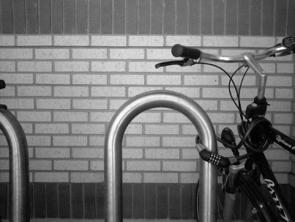
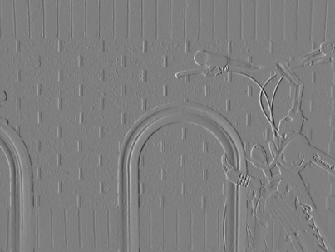
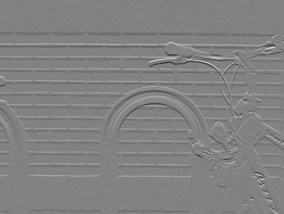
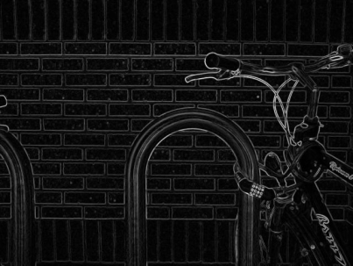

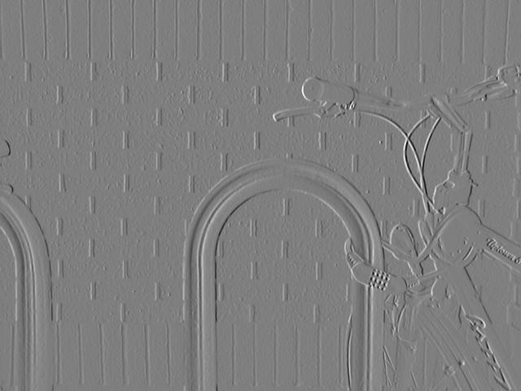
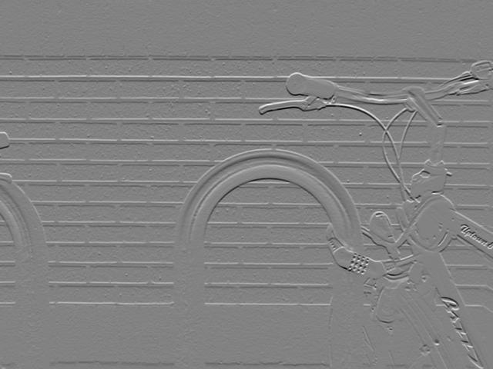
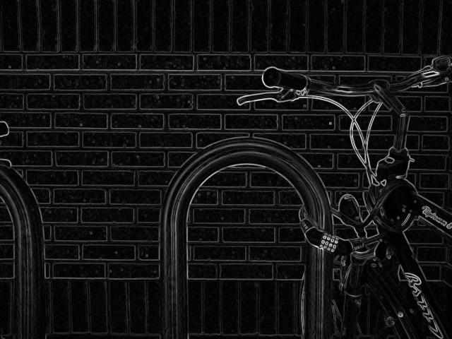
Sobel operator: example
Source: Wikipedia

Slide 17
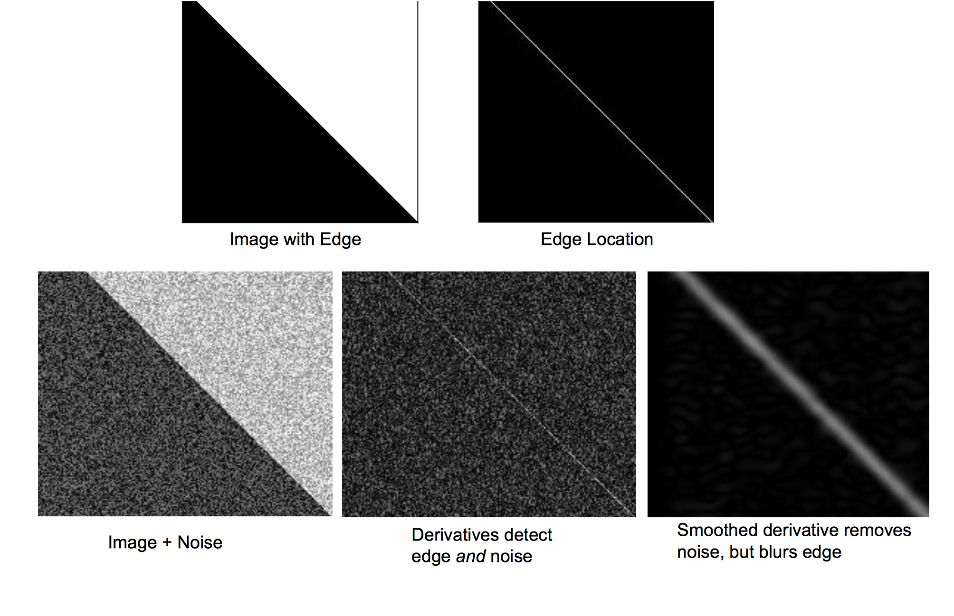

Slide 18
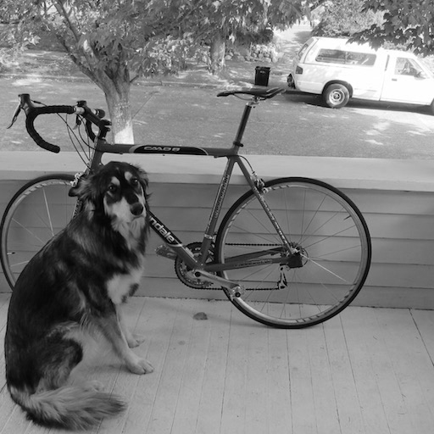
Example
original image
Demo: http://bigwww.epfl.ch/demo/ip/demos/edgeDetector/
Image credit: Joseph Redmon

Slide 19
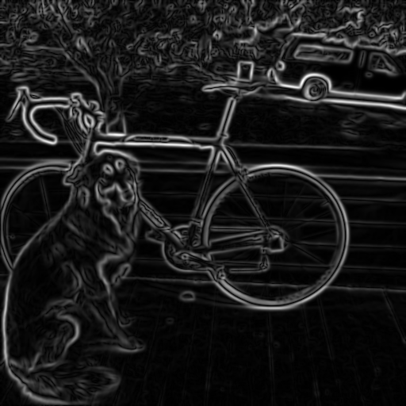
Finding edges
smoothed gradient magnitude

Slide 20

Finding edges
where is the edge?
thresholding

Slide 21
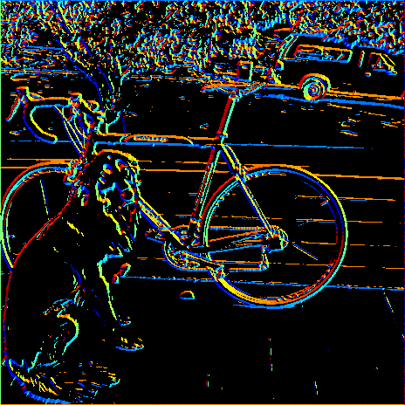
Get Orientation at Each Pixel
Get orientation (below, threshold at minimum gradient magnitude)
θ = atan2(gy, gx)
360
Gradient orientation angle
0

Slide 22

Non-maximum supression
Check if pixel is local maximum along gradient direction
  requires interpolating pixels p and r

Slide 23
Before Non-max Suppression

Slide 24
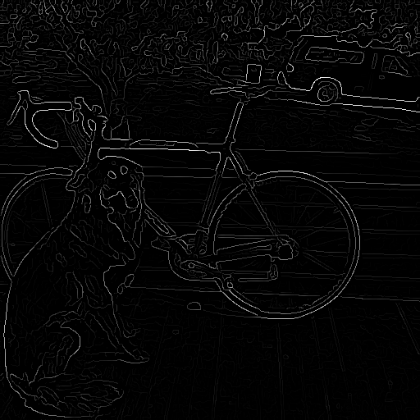
After Non-max Suppression

Slide 25
Thresholding edges
Still some noise
Only want strong edges
2 thresholds, 3 cases
  R > T: strong edge
  R < T but R > t: weak edge
  R < t: no edge
Why two thresholds?

Slide 26
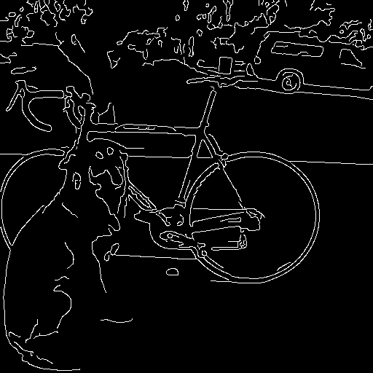
Connecting edges
Strong edges are edges!
Weak edges are edges
iff they connect to strong
Look in some neighborhood
(usually 8 closest)

Slide 27

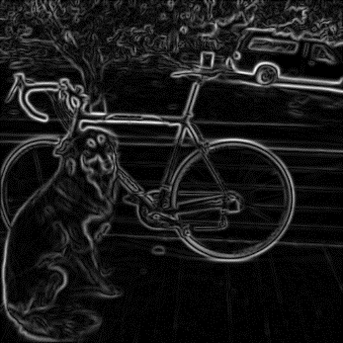


Canny edge detector
MATLAB: edge(image,‘canny’)
Filter image with derivative of Gaussian
Find magnitude and orientation of gradient
Non-maximum suppression
Linking and thresholding (hysteresis):
  Define two thresholds: low and high
  Use the high threshold to start edge curves and the low threshold to continue them
Source: D. Lowe, L. Fei-Fei, J. Redmon

Slide 28

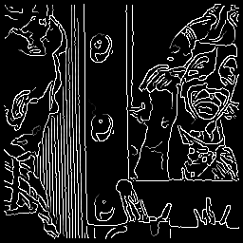




Canny edge detector
original
Canny with
Canny with
The choice of depends on desired behavior
  large detects “large-scale” edges
  small detects fine edges
Source: S. Seitz

Slide 29
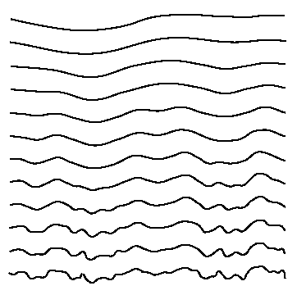
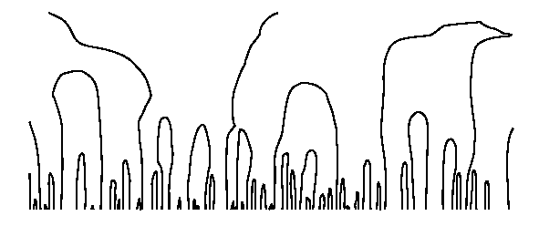

Scale space [Witkin 83]
first derivative peaks
larger
Gaussian filtered signal
Properties of scale space (w/ Gaussian smoothing)
  edge position may shift with increasing scale (σ)
  two edges may merge with increasing scale
  an edge may not split into two with increasing scale

Slide 30
Questions?

